Slide 1
Introduction to C

Slide 2
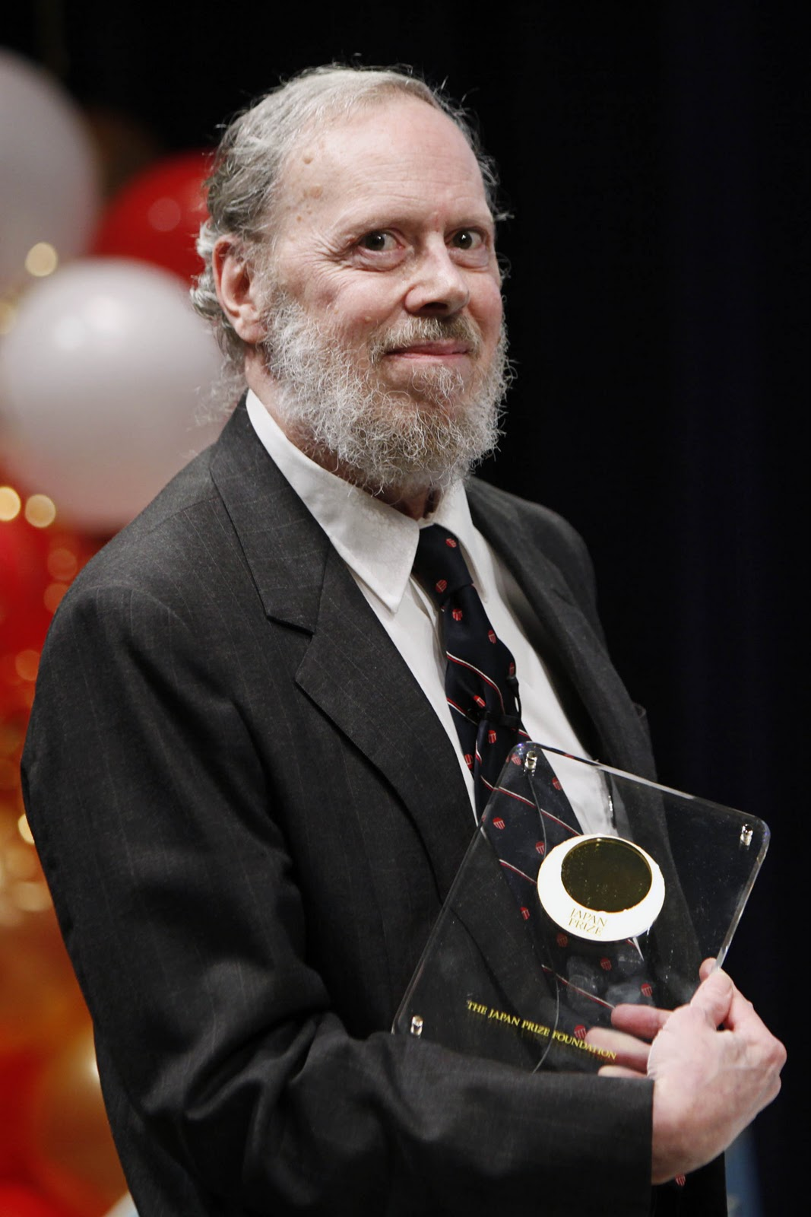
→ C programming language was developed in 1972 by Dennis Ritchie at bell laboratories of AT&T(American Telephone & Telegraph), located in U.S.A.
History of c
------------------------------------------------------------------------------
→ It was developed to be used in UNIX Operating system.
→ It is one of the most popular computer language today because it is structured,
High level, machine dependent language.

Slide 3
Computer only understands Binary language which includes 0 and 1
So process will be like this:-
User Input → Data → Processed → Information
We press ‘A’ on the keyboard → ASCII value of ‘A’ is 65.
ASCII → American Standard code for Information interchange.
It will convert this decimal number into Binary.
Ex.1000001

Slide 4
Data types in C
There are main 2 types of datatype and C language have Total 3 Datatypes.
1.Primitive /Built in/Primary 2.Non Primitive
→int →Derived → Array,Function,Pointer(AFP)
→long int
→float →User defined → Structure,Union
→double
→char
----------------------------------------------------------------------------------------------------------------------------------------

Slide 5
Primary Data type------------------------It’s Formating
1.int “%d”
2.long int ` “%ld”
3.float “%f”
4.double “%lf”
5.Char “%c”

Slide 6
Primary Data type-------It’s Formating
1.int “%d” Range(+32,767 || -32,768)
2.long int “%ld”
3.float “%f”
4.double “%lf”
5.Char “%c” Range(127)

Slide 7
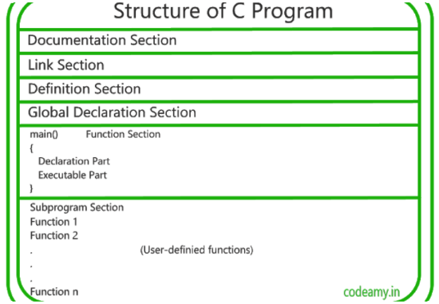

Slide 8
Documentation Section
Comments :-
/*
Name :- Kavyan Nayak
Date :- 08/04/2024
obj :- Intro About C
Multiline Comment
*/
// Single line Comment
Whatever we write in comment section will be not a part of our entire code while executing this code.

Slide 9
Header files In C
C programs are divided into modules or functions.
Some functions are written by users, like us, and many others are stored in C
library.
Library functions are grouped category wise and stored in different files known
as header files.
If we want to access the functions stored in the library, it is necessary to tell the
compiler about the files to be accessed
This can be achieved by
#include<Filename>
These preprocessor directives are placed at the beginning of a program.
-------------------------------------------------------------------------------------------------------------------------------

Slide 10
printf and scanf are included by <stdio.h> header file
clrscr and getch are included by <conio.h> header file

Slide 11
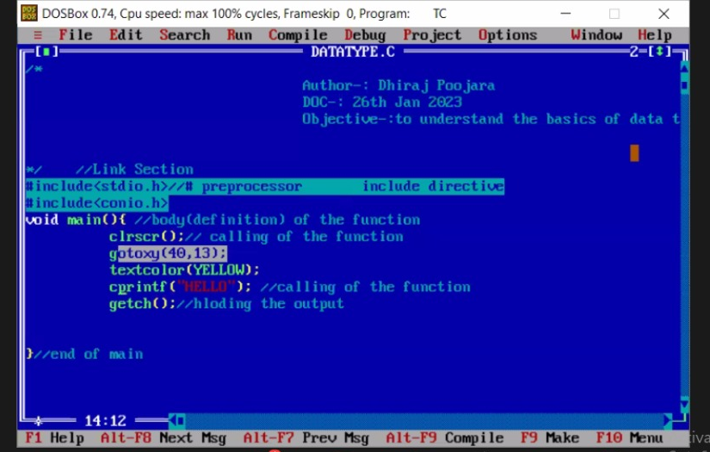

Slide 12
Executing a C program
Executing a program written in C involves a series of steps. These are:
Creating the program.
Compiling the program.
Linking the program with functions that are needed from the C library.
Executing the program.
------------------------------------------------------------------------------------------------------------------------------

Slide 13
Tokens
There are total 6 types of Tokens in C
Keywords → There are 32 Keywords reserved by C.
Identifiers → count
String →”Royal”
Special symbols →{ },[ ]
Constants →a=15;
Operators →8 types of Operators
--------------------------------------------------------------------------------------------------------------

Slide 14
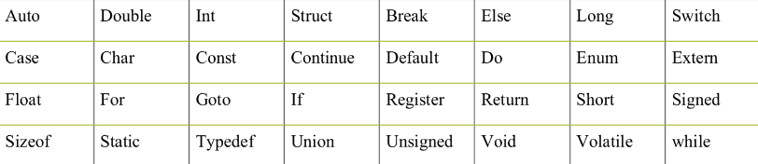

Slide 15
Rules to name a Variable
Should not be a reserved word.
Should start with a alphabet or a underscore (_)
Can contain letters, numbers or underscore
No other special characters allowed including space
Variable names are case sensitive
‘A’ and ‘a’ are different.

Slide 16
Which of the following is an Invalid variable name?
Cht
Prin$e
int_type
A_b

Slide 17
Operators :-
Arithmetic Operators
Relational Operators
Logical Operators
Assignment Ooperators
Increment and decrement operators
Conditional operators
Bitwise operators
Special operators

Slide 18
Arithmetic Operators
Any variable called operand ex.A+b here A and B are Operands
And +,-,*,/ are called as Operators which will perform basic Arithmetic operation.
There are 3 types of operation:-
1.Binary operation → a+b;
2.Unary operation → a++;
3.Ternary operation → c=a<b?9:18;
------------------------------------------------------------------------------------------------------------------------------------------

Slide 19
Arithmetic Operations
-----------------------------------------------------------------------------------------------------------------------------------------
Addition → +
Subtraction → -
Multiplication → *
Division → /
Modulus → % (It will return remender)

Slide 20
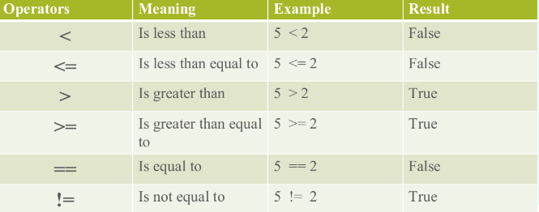
Relational operators
----------------------------------------------------------------------------------------------------------------------------------------
It will compare two operands values with each other.

Slide 21
Logical Operators
--------------------------------------------------------------------------------------------------------------------------
1.&& (If expression 1 and expression 2 both are true than condition will be true)
2.|| (If expression 1 or expression 2 one of it is true then condition will be true)
3.! (!expr1 has value True if expr1 is false else its value is false)

Slide 22
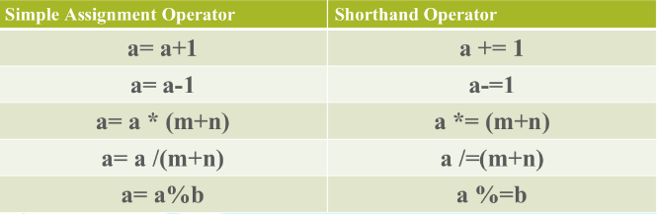
Assignment Operators
--------------------------------------------------------------------------------------------------------------------------------------------------
(=)
It will assign a value in variable and return answer of operation.

Slide 23
Increment Decrement Operators
-------------------------------------------------------------------------------------------------------------------------------------------------------
Increment: Decrement:
1.Pre-increment :- ++a; 1.Pre-decrement :- --a;
2.Post-increment :- a++; 2.Post-decrement :- a--;
Difference Between Post and Pre:-
Post :- In post increment or decrement first value will be assigned and after that increment or decrement will be performed.
Pre :- In pre increment or decrement first increment or decrement will be performed and according to the operation value will be assigned.

Slide 24
Conditional Operator
------------------------------------------------------------------------------------------
C language provides “?” operator as a conditional operator.
These are “Ternary Operators” as they take three operands.
It is used as shown below:
Syntax:
Condition ? Expression1 : Expression2
The statement above is equivalent to:
if (Condition)
Expression1
else
Expression2

Slide 25
Thank you

